Slide 1
Category review: Chips
June 2020
Retail Analytics

Slide 2
Notes:
To view Privacy video explaining how important data privacy is to Quantium, please click here: https://www.youtube.com/watch?v=Zq1QDAkoRzU
or here Q:\Company Reference\Brand & Design\Brand videos\Q Privacy.mp4
At Quantium, we believe that data is the behavioural footprint of humanity and that it has to be treated with the utmost care and responsibility.
Histories, attitudes, indeed lives are stored within it in ways that aren’t always apparent – and that’s what makes its potential so powerful.
To work with it responsibly, sensitively, we set ourselves the highest data privacy protection and governance standards.
We have spent 17 years perfecting privacy-by-design and secure-by-design principles. Central to this is not holding any personally identifiable information about people –
we neither receive it, and put the necessary protections in place to be unable to decipher it.
Every aspect of handling data is safeguarded: from its de-identification, to its encryption – data security is paramount and of the highest grade.
We pride ourselves on gaining the trust of iconic organisations around the world through years of securely working with their data,
and in turn the trust that builds with their stakeholders.

Slide 3
Executive summary
01
The Transaction of Chips increased prior to Christmas , a great time take and advantage of
.
Old Families and young single couples have highest purchase.
Kettle company got the highest number of product purchase
Task 1
02
Task 2
Total sale and chip per customer has a not much great variance.
Total sale for 77,86,89 for Trail store has fallen down drastically, constant, slightly fallen, respectively.
Got slight difference in percentage, for trail shops.

Slide 4
01
Data Visualization on Purchase and Transactional behaviours.

Slide 5
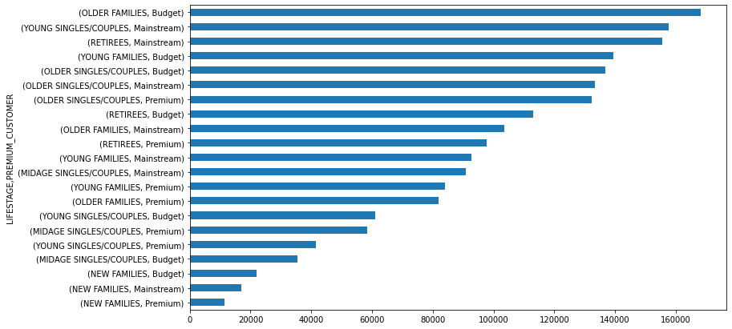
Overview: A visualization od Lifestage, Premium Customers and to the total sales.

Slide 6
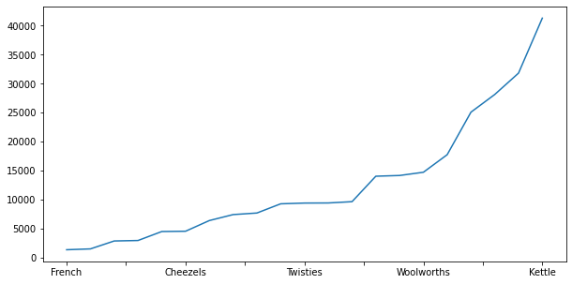
Usage based on Brand.

Slide 7
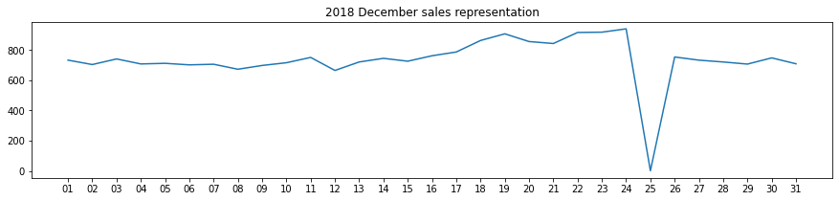
Editable (delete this)
Sales representation according to dates.

Slide 8
02
Trial store performance

Slide 9
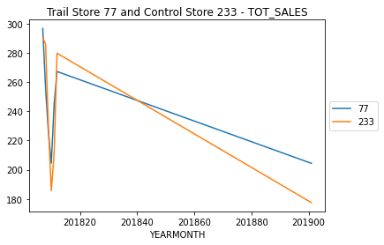
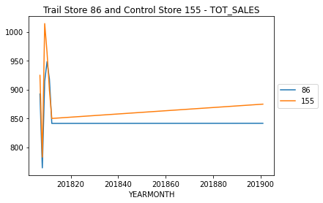
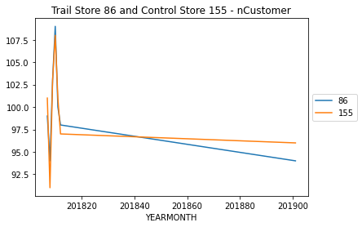
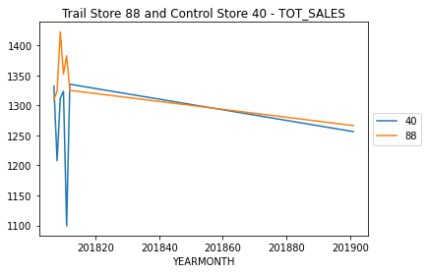
Explanation of the control store vs other stores.

Slide 10
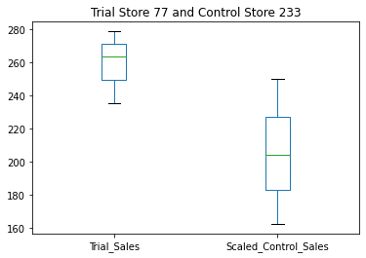
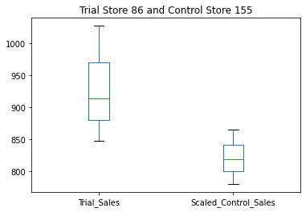
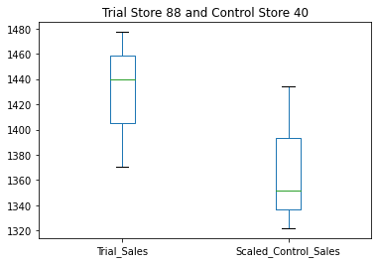
A Description of trial and control sales.

